Slide 1

Return of Investment of Hazard Mitigation Projects
By: Rachel Beery

Slide 2
Problem Statement
Our client FEMA has tasked us with studying the success of hazard mitigation by analyzing hazard mitigation projects of the past and recovery projects to find what projects yield the highest return of investment.

Slide 3
Data
There is an OpenFEMA datasets used in this analysis.
Hazard Mitigation project information is found in the first dataset
Features of importance include region, state, project amount, program fiscal year, benefit cost ratio, and net value benefits
Our modeling begins in 1999 when reporting began for recovery projects

Slide 4
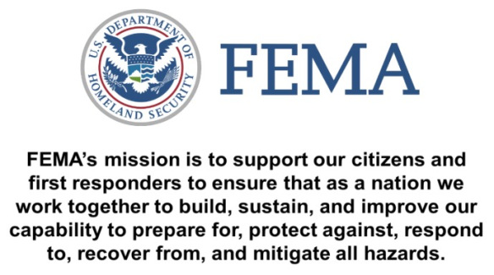

Slide 5
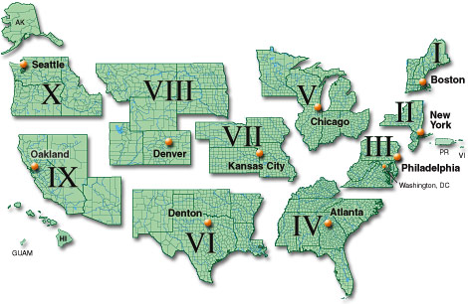

Slide 6
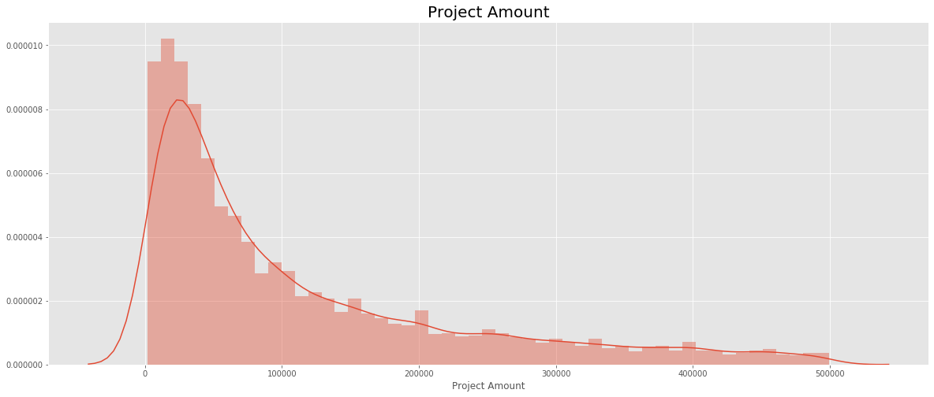
Mean Cost of Hazard Mitigation:
$815,798.37
Median Cost of Hazard Mitigation:
$114,895.50

Slide 7
Program Areas
HMGP - Hazard Mitigation Grant Program
FMA - Flood Mitigation Assistance grant program,
PDM - Pre-disaster Mitigation grant program
RFC - Repetitive Flood Claims grant program
SRL - Severe Repetitive Loss grant program
LPDM -Legislative Pre-disaster Mitigation grant program

Slide 8
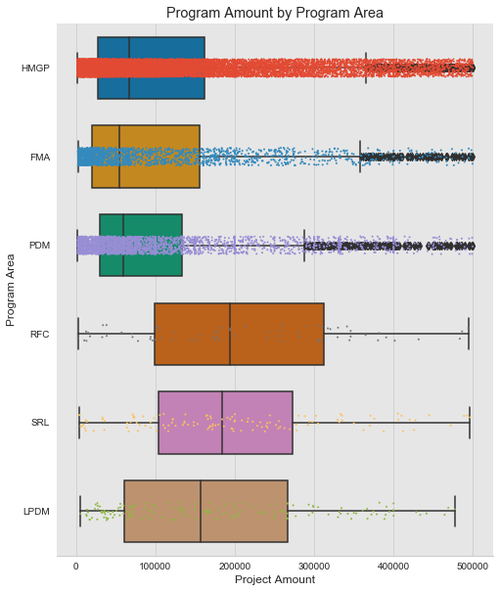
HMGP - Hazard Mitigation Grant Program
FMA - Flood Mitigation Assistance grant program,
PDM - Pre-disaster Mitigation grant program
RFC - Repetitive Flood Claims grant program
SRL - Severe Repetitive Loss grant program
LPDM -Legislative Pre-disaster Mitigation grant program

Slide 9
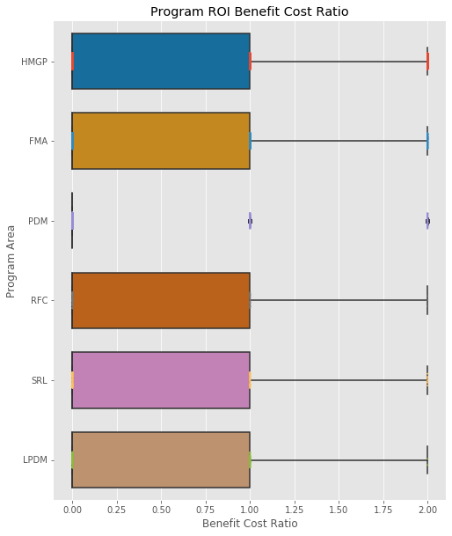
HMGP - Hazard Mitigation Grant Program
FMA - Flood Mitigation Assistance grant program,
PDM - Pre-disaster Mitigation grant program
RFC - Repetitive Flood Claims grant program
SRL - Severe Repetitive Loss grant program
LPDM -Legislative Pre-disaster Mitigation grant program

Slide 10
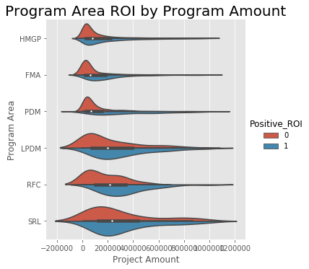
HMGP - Hazard Mitigation Grant Program
FMA - Flood Mitigation Assistance grant program,
PDM - Pre-disaster Mitigation grant program
RFC - Repetitive Flood Claims grant program
SRL - Severe Repetitive Loss grant program
LPDM -Legislative Pre-disaster Mitigation grant program

Slide 11
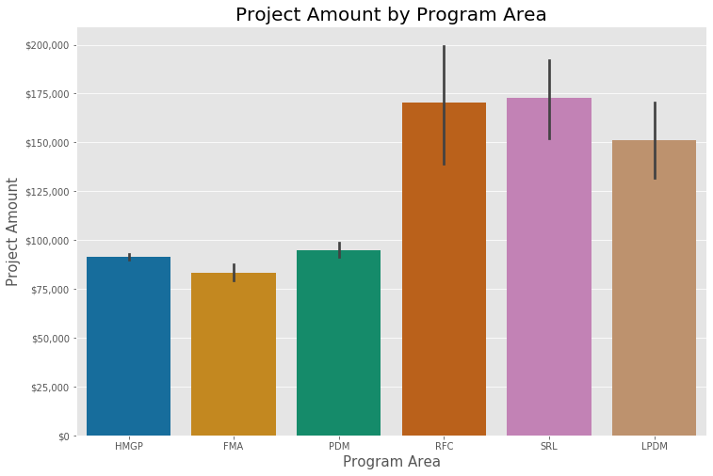
HMGP - Hazard Mitigation Grant Program
FMA - Flood Mitigation Assistance grant program,
PDM - Pre-disaster Mitigation grant program
RFC - Repetitive Flood Claims grant program
SRL - Severe Repetitive Loss grant program
LPDM -Legislative Pre-disaster Mitigation grant program
Notes:
FMA - Flood Mitigation Assistance grant program, HMGP - Hazard Mitigation Grant Program, LPDM -Legislative Pre-disaster Mitigation grant program, PDM - Pre-disaster Mitigation grant program, RFC - Repetitive Flood Claims grant program, SRL - Severe Repetitive Loss grant program

Slide 12
Regions

Slide 13
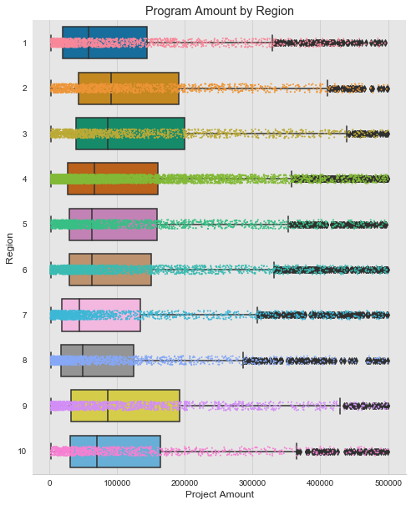
Notes:
States including alaska, dc, arizona, louisiana, puerto rico, idaho
Region 1 Connecticut | Maine | Massachusetts | New Hampshire | Rhode Island | Vermont
Region 2 New Jersey | New York | Puerto Rico | Virgin Islands
Region 3 Delaware | Maryland | Pennsylvania | Virginia | District of Columbia | West Virginia
Region 4 Alabama | Florida | Georgia | Kentucky | Mississippi | North Carolina | South Carolina | Tennessee
Region 5 Illinois | Indiana | Michigan | Minnesota | Ohio | Wisconsin
Region 6 Arkansas | Louisiana | New Mexico | Oklahoma | Texas
Region 7 Iowa | Kansas | Missouri | Nebraska
Region 8 Colorado | Montana | North Dakota | South Dakota | Utah | Wyoming
Region 9 Arizona | California | Hawaii | Nevada | Guam | American Samoa | Commonwealth of Northern Mariana Islands | Republic of Marshall Islands | Federated States of Micronesia
Region 10 Alaska | Idaho | Oregon | Washington

Slide 14
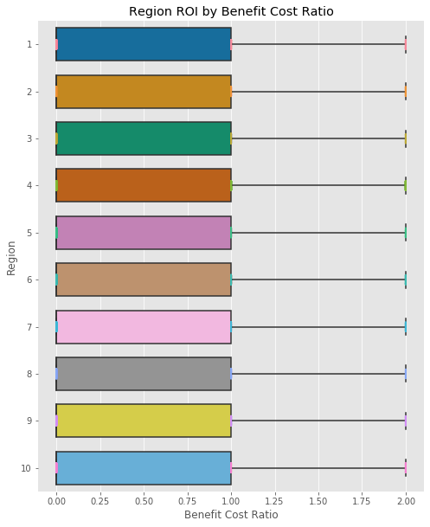
Notes:
States including alaska, dc, arizona, louisiana, puerto rico, idaho
Region 1 Connecticut | Maine | Massachusetts | New Hampshire | Rhode Island | Vermont
Region 2 New Jersey | New York | Puerto Rico | Virgin Islands
Region 3 Delaware | Maryland | Pennsylvania | Virginia | District of Columbia | West Virginia
Region 4 Alabama | Florida | Georgia | Kentucky | Mississippi | North Carolina | South Carolina | Tennessee
Region 5 Illinois | Indiana | Michigan | Minnesota | Ohio | Wisconsin
Region 6 Arkansas | Louisiana | New Mexico | Oklahoma | Texas
Region 7 Iowa | Kansas | Missouri | Nebraska
Region 8 Colorado | Montana | North Dakota | South Dakota | Utah | Wyoming
Region 9 Arizona | California | Hawaii | Nevada | Guam | American Samoa | Commonwealth of Northern Mariana Islands | Republic of Marshall Islands | Federated States of Micronesia
Region 10 Alaska | Idaho | Oregon | Washington

Slide 15
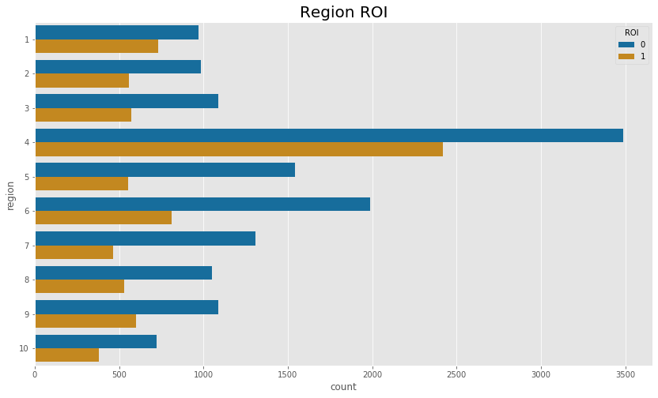
Notes:
States including alaska, dc, arizona, louisiana, puerto rico, idaho
Region 1 Connecticut | Maine | Massachusetts | New Hampshire | Rhode Island | Vermont
Region 2 New Jersey | New York | Puerto Rico | Virgin Islands
Region 3 Delaware | Maryland | Pennsylvania | Virginia | District of Columbia | West Virginia
Region 4 Alabama | Florida | Georgia | Kentucky | Mississippi | North Carolina | South Carolina | Tennessee
Region 5 Illinois | Indiana | Michigan | Minnesota | Ohio | Wisconsin
Region 6 Arkansas | Louisiana | New Mexico | Oklahoma | Texas
Region 7 Iowa | Kansas | Missouri | Nebraska
Region 8 Colorado | Montana | North Dakota | South Dakota | Utah | Wyoming
Region 9 Arizona | California | Hawaii | Nevada | Guam | American Samoa | Commonwealth of Northern Mariana Islands | Republic of Marshall Islands | Federated States of Micronesia
Region 10 Alaska | Idaho | Oregon | Washington

Slide 16
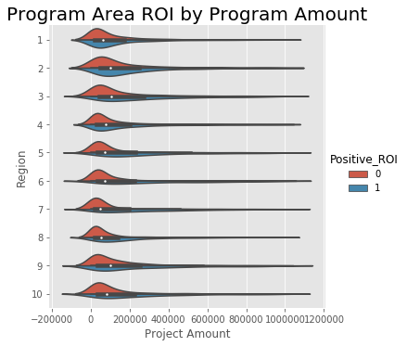
Notes:
States including alaska, dc, arizona, louisiana, puerto rico, idaho
Region 1 Connecticut | Maine | Massachusetts | New Hampshire | Rhode Island | Vermont
Region 2 New Jersey | New York | Puerto Rico | Virgin Islands
Region 3 Delaware | Maryland | Pennsylvania | Virginia | District of Columbia | West Virginia
Region 4 Alabama | Florida | Georgia | Kentucky | Mississippi | North Carolina | South Carolina | Tennessee
Region 5 Illinois | Indiana | Michigan | Minnesota | Ohio | Wisconsin
Region 6 Arkansas | Louisiana | New Mexico | Oklahoma | Texas
Region 7 Iowa | Kansas | Missouri | Nebraska
Region 8 Colorado | Montana | North Dakota | South Dakota | Utah | Wyoming
Region 9 Arizona | California | Hawaii | Nevada | Guam | American Samoa | Commonwealth of Northern Mariana Islands | Republic of Marshall Islands | Federated States of Micronesia
Region 10 Alaska | Idaho | Oregon | Washington

Slide 17
Program Costs & Benefit Cost Ratios Over Time

Slide 18
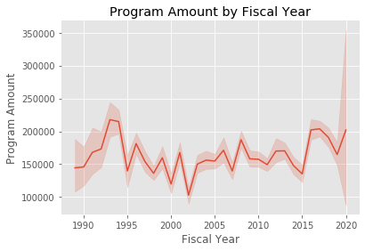

Slide 19
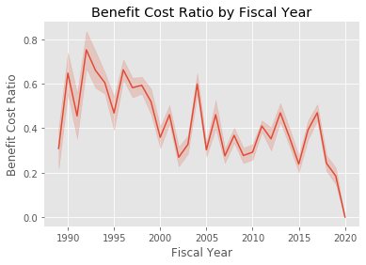

Slide 20
Recommendations
Program Areas
More funds should be allocated to hazard mitigation in all categories of hazard mitigation with the HMGP being the most common program
Regions
Certain areas of the US are more prone to natural disasters and need more funding for hazard mitigation including 1, 2, 4, and 9 having the best ROI
Regions 6 & 7 having the lowest ROI
Program Costs & ROI
The costs of COVID-19 surpass all categories of natural disaster recovery costs and were unprecedented
There could have been further preparation

Slide 21
Future Work
Budgets in Hazard Mitigation Project Areas
HMGP - Hazard Mitigation Grant Program
FMA - Flood Mitigation Assistance grant program,
PDM - Pre-disaster Mitigation grant program
RFC - Repetitive Flood Claims grant program
SRL - Severe Repetitive Loss grant program
LPDM -Legislative Pre-disaster Mitigation grant program
Funding allocation
Community Preparation

Slide 22
Thank you!
Data provided by FEMA at the following website:
https://www.fema.gov/openfema-data-page/disaster-declarations-summaries-v2

Slide 23
Appendix
Focus on Tribal Projects

Slide 24
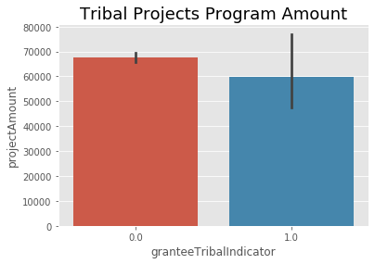

Slide 25
